Slide 1



Breaking the Unbreakable: Evaluating the Breakability of a 64 -bit Ring Oscillator PUF Using Machine Learning Techniques.
Team Members
KAIPA SRI CHARAN

Slide 2
Introduction
Physical Unclonable Functions (PUFs) are emerging as a promising technology for secure authentication and key generation.
The XOR PUF, in particular, is a popular type of PUF that uses XOR logic gates to generate unique responses to challenge inputs.
XOR PUFs have been studied extensively due to their simplicity and ease of implementation.
However, recent research has shown that XOR PUFs can be vulnerable to attacks, and their security is highly dependent on the quality of their hardware implementation.
We explore the breakability of XOR PUFs using machine learning techniques.
Machine learning has shown significant potential in analyzing and exploiting vulnerabilities in cryptographic systems.
To achieve our goal, we first introduce the concept of PUFs and their significance in the field of cybersecurity.
We then discuss the architecture and working principle of the XOR PUF and the existing attacks on XOR PUFs.

Slide 3
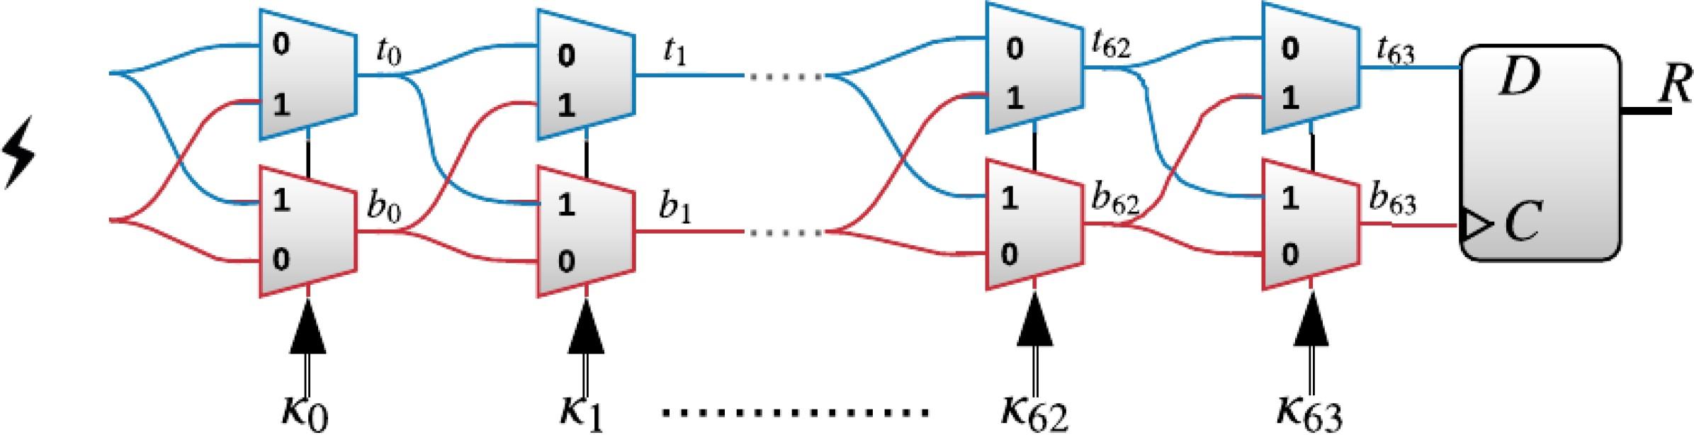
PHYSICAL UNCLONABLE FUNCTION
The 64-bit XOR PUF shown in Fig-1 is a type of physical unclonable function (PUF) that relies on the measurement of the delay of a signal propagating through a set of XOR gates.
The XOR PUF is designed in such a way that the signal will take a longer time to propagate through one of the inputs than the other.
A 64-stage physical unclonable functions (PUF) arbiter, where each stage has two multiplexers and the number of stages corresponds to the challenge’s bit count in above figure.

Slide 4

PHYSICAL UNCLONABLE FUNCTION
The 64-bit XOR PUF works by selecting two different inputs through the XOR gate, and XORing the signals that are output from each input.
The resulting output is a function of the difference in delay times between the two inputs, and it is unique to each individual circuit.
This output can be used as a cryptographic key or as a unique identifier for the circuit.
One of the advantages of the 64-bit XOR PUF is that it is resistant to modeling attacks, which are attacks that attempt to predict the behavior of the PUF by creating a model of the circuit.
The 9-XOR PUF is a physical unclonable function (PUF) that generates a unique output for each individual circuit.

Slide 5

PHYSICAL UNCLONABLE FUNCTION
It works by XORing the signals from nine different inputs, and the resulting output is a function of the delay times between the inputs.
This output can be used as a cryptographic key or as a unique identifier for the circuit. One of the advantages of the 9-XOR PUF is that it is resistant to modeling attacks, which attempt to predict the behavior of the PUF by creating a model of the circuit.
This is because the delay times are affected by a large number of factors that are difficult to model accurately, such as the exact position of the gates and the variations in the manufacturing process.
However, the 9-XOR PUF is vulnerable to machine learning-based attacks, which can clone the PUF by learning the relationship between the delay times and the output.
To protect against machine learning-based attacks, researchers have proposed several defense mechanisms.
One approach is to add noise to the input or output of the PUF, which makes it more difficult for the attacker to learn the relationship between the delay times and the output.
Another approach is to use multiple PUFs in parallel and combine their outputs in a way that is difficult for the attacker to model.
Additionally, machine learning algorithms can be used to detect and mitigate attacks.

Slide 6

PREVIOUS RESEARCH WORKS
Ruhrmair et al.'s 2010 research used logistic regression to accurately predict responses to up to six 128-bit XPUF assaults, resulting in a training time of up to 31.01 hours.
Tobisch and Becker's research and use of logistic regression resulted in a longer training period for the 8-XPUF 64-bit, with a maximum prediction accuracy of 98 percent.
Hospodar, Maes, and Verbauwhede used a multilayer perceptron (MLP) or feed-forward neural network to predict outcomes for 2-XPUFs through 64-bit problems with a 90 percent accuracy. Four neurons were employed in a single layer of the MLP.

Slide 7

PREVIOUS RESEARCH WORKS
Alkatheiri et al. proposed a new MLP architecture for feed-forward arbitrator PUFs with varying loop counts, which can crack 64- and 128-bit challenges using three hidden layers.
A neural network-based method was 100 percent effective in breaking 64-bit 9-XPUFs using four million CRPs from paper research. By 2020, researchers will have studied XOR PUFs using Rapid Deep Learning.

Slide 8
DATASET
The binary 9-XOR PUF dataset consists of 64 input-output pairs. Each 0 or 1 bit output corresponds to a 9-bit input.
This dataset is commonly used in the study of physically unclonable functions to evaluate PUFs performance.
A PUF is a physical device that, when confronted with a challenge, generates an innovative and unexpected response.
The 9-XOR PUF dataset has been used in research to comprehensively investigate the performance of various PUF designs.
Examining trade-offs between PUFs’ uniqueness, reliability, and predictability may be done using the dataset.

Slide 9
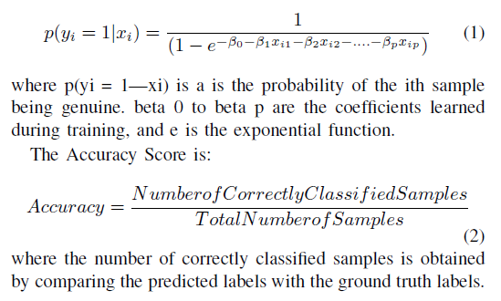
LOGISTIC REGRESSION
The Logistic Regression for Binary Classification is:

Slide 10

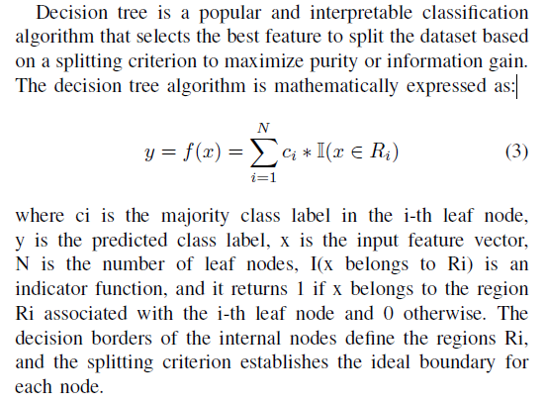
RANDOM FOREST

Slide 11
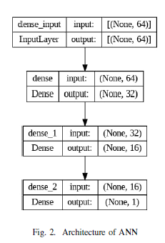
ARTIFICIAL NEURAL NETWORK
The first two dense layers of the model architecture, which are shown in Flowchart, employ the rectified linear unit (ReLU) activation function. One node with a sigmoid activation function is included in the final layer. The binary cross-entropy loss function and Adam optimizer are both used to optimise the model parameters.

Slide 12
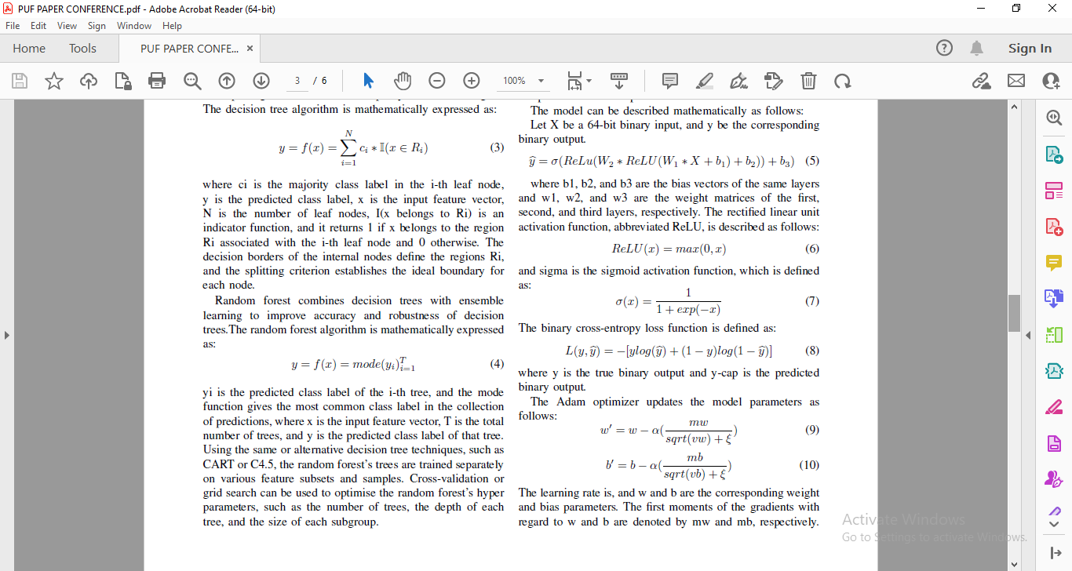
ARTIFICIAL NEURAL NETWORK

Slide 13
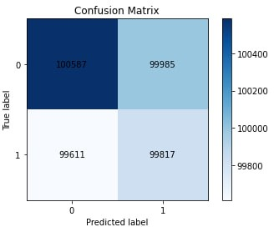
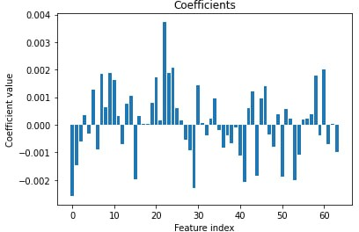
GRAPHS AND OUTPUTS
Confusion Matrix For Logistic Regression
Feature Index Using Logistic Regression

Slide 14
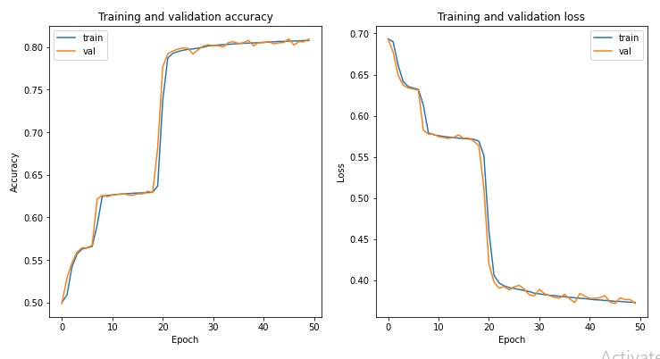
Graphs AND OUTPUTS
TRAINING AND TESTING ACCURACY PLOTS USING ANN

Slide 15
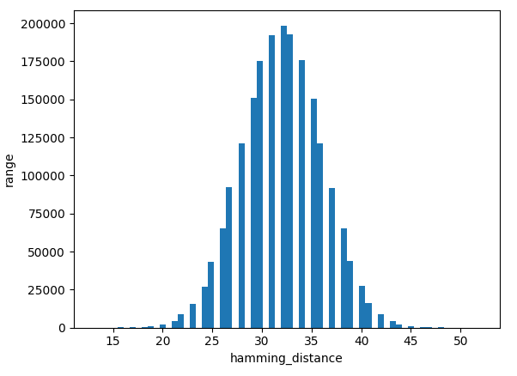
GRAPHS AND GRAPHS
HAMMING CODE APPROACH

Slide 16
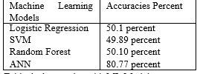
RESULT
We have Implemented the Machine Learning PUF Breakability with different Architectures and we got different architecture with different outputs. Here we are representing outputs in Tabular Format

Slide 17
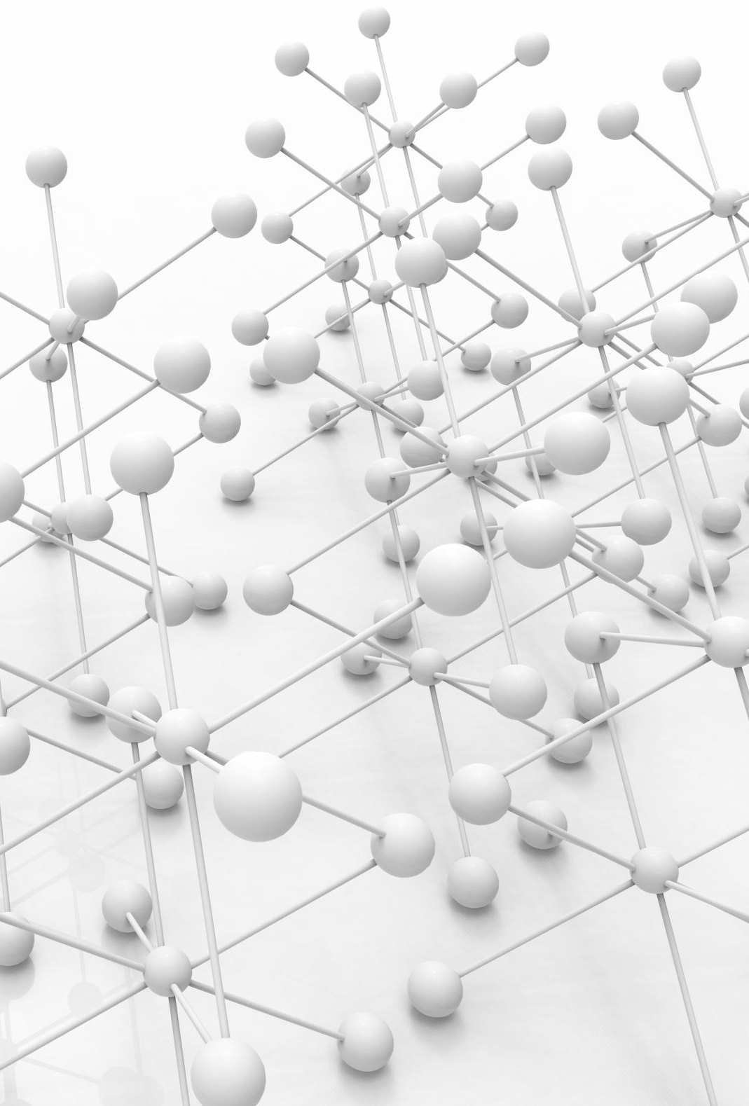
CONCLUSION
According to our research, the ANN (Artificial Neural Network) model looks to have the best accuracy rate, at 80.77 percent, while the accuracy rates for the Logistic Regression, SVM, and Random Forest models are all close to 50 percent.
The link between delay times and the output of the 9-XOR PUF is thought to be best predicted by the ANN model, according to this evidence.
It is crucial to keep in mind, nonetheless, that the available data is insufficient to accurately assess how well these machine learning models are doing.
The quantity and calibre of the training dataset, the complexity of the model architecture, and the intricacies of the implementation can all have an impact on the models’ accuracy.
Furthermore, the particular defence strategies used may affect how successful machine learning assaults are against the 9-XOR PUF.

Slide 18


